Slide 1
Module-1: OOPS CONCEPTS AND JAVA PROGRAMMING:
OOP concepts: Classes and objects, data abstraction, encapsulation, inheritance, benefits of inheritance, polymorphism, procedural and object oriented programming paradigm.
Java programming: History of java, comments data types, variables, constants, scope and life time of variables, operators, operator hierarchy, expressions, type conversion and casting, enumerated types, control flow statements, jump statements simple java stand alone programs, arrays, console input and output, formatting output, constructors methods, parameter passing, static fields and methods, access control, this reference, overloading methods and constructors, recursion, garbage collection, exploring string class

Slide 2
Method Overloading and Constructor Overloading:
Method Overloading and Constructor Overloading in Java are concepts that allow multiple methods or constructors to have the same name but different parameters within the same class. They help improve code readability and flexibility by enabling the same method or constructor to perform different tasks based on the input parameters.
Polymorphism : Compile Time Polymorphism.

Slide 3
Method Overloading:
Definition: Method overloading occurs when two or more methods in the same class have the same name but differ in the number or type of parameters.
Key Points:
Methods must have different parameter lists (either in number, type, or order of parameters).
The return type can be the same or different, but it doesn't influence overloading.
Overloading enhances code readability and reusability.

Slide 4
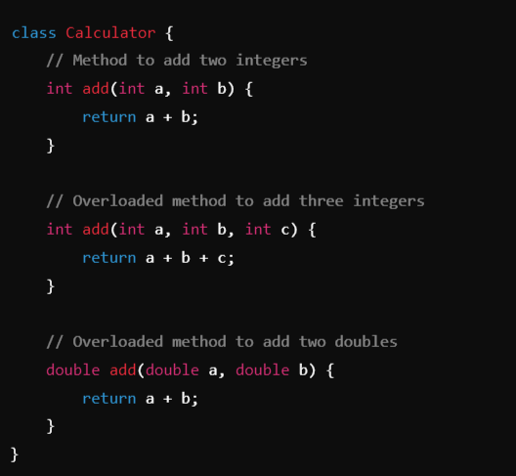
Example:

Slide 5
Constructor Overloading:
Definition: Constructor overloading occurs when a class has multiple constructors with the same name (the class name) but different parameter lists.
Key Points:
Allows creating objects in different ways depending on the arguments passed.
Like method overloading, constructors must differ in the number, type, or order of parameters.
It provides flexibility in initializing objects with different sets of data.

Slide 6
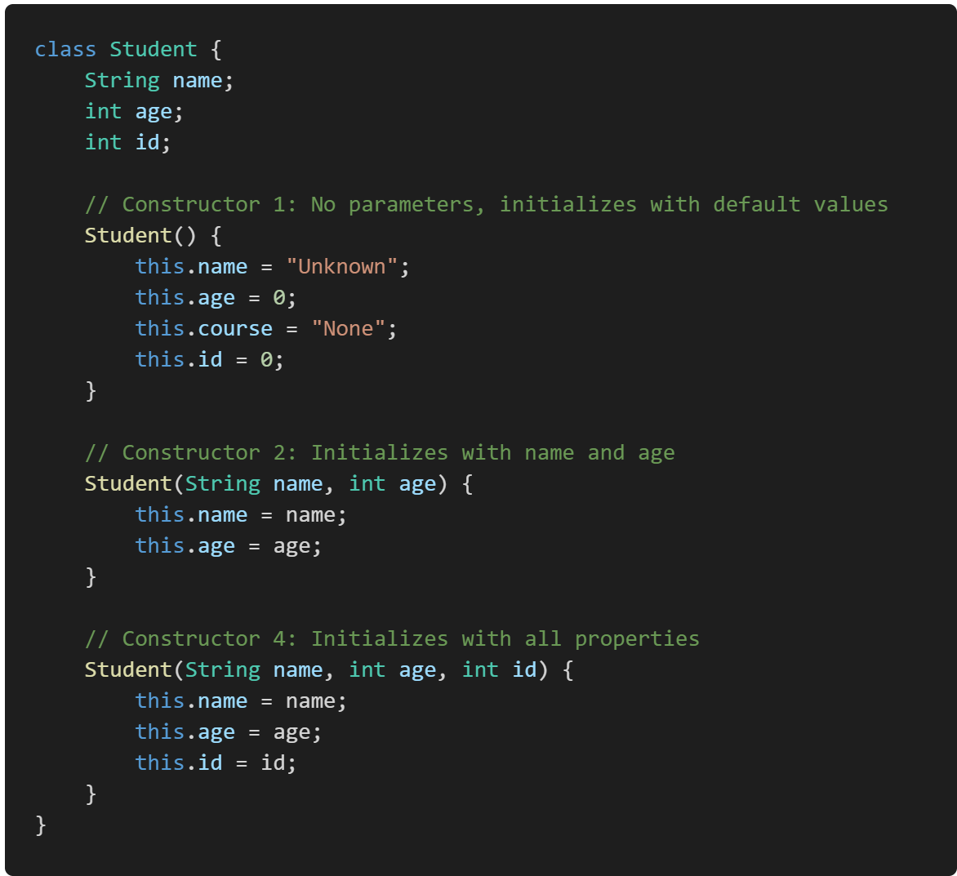
Example:

Slide 7
Run-Time Polymorphism

Slide 8
Method overriding:
Method overriding in Java is a feature that allows a subclass to provide a specific implementation of a method that is already defined in its superclass. This is used to achieve runtime polymorphism and enable the subclass to customize or enhance the behavior of the inherited method.
Key Points of Method Overriding:
Same Method Signature: The overriding method in the subclass must have the same name, return type, and parameters as the method in the superclass.
Annotation: The @Override annotation is often used above the method in the subclass to indicate that it is overriding a method from its superclass (though it is optional).
Access Modifiers: The access level of the overriding method cannot be more restrictive than the overridden method.
Instance Methods Only: Only instance methods (non-static methods) can be overridden. Static methods are not overridden but are hidden instead.

Slide 9
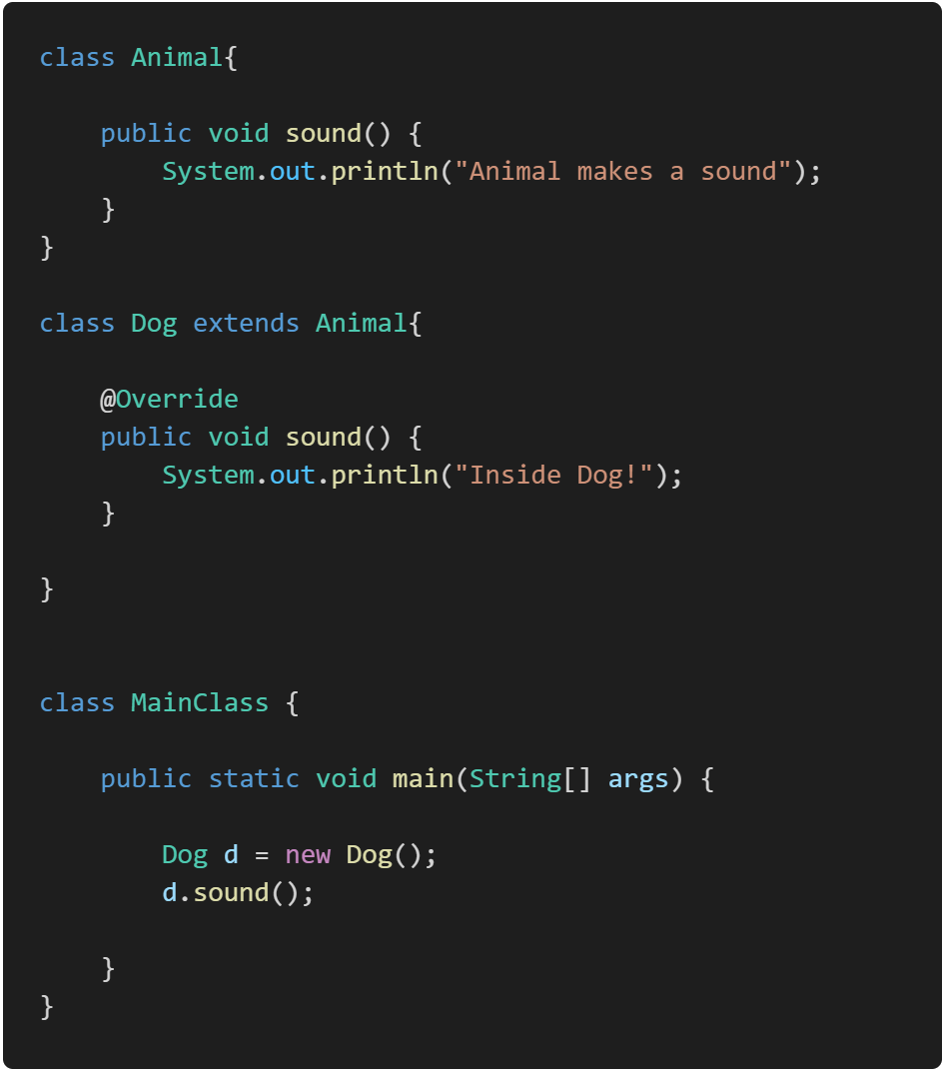
Example:

Slide 10
How to Prevent Method Overriding

Slide 11
Type conversion and Casting:
Type Conversion and Casting in Java are processes that allow you to convert one data type into another. These operations are essential when you need to work with different types of data together.
https://yuvrajscorpio.medium.com/type-casting-in-java-8175fa2875ee

Slide 12
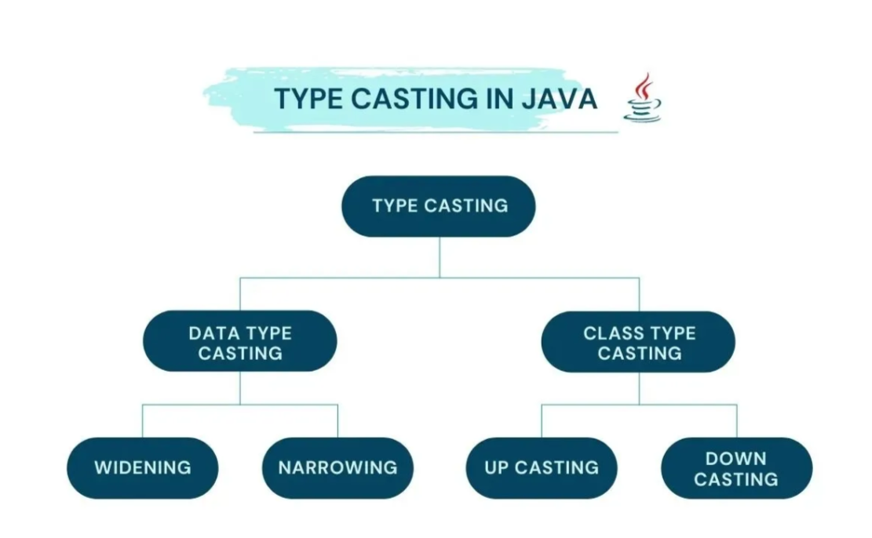

Slide 13
Type Conversion or Casting:
Type conversion, also known as type casting, is the process of converting a value from one data type to another. There are two types of type conversion in Java:
Implicit (Automatic or widening Casting) Type Conversion
Explicit Type Conversion (Casting or Narrowing Casting)

Slide 14
a. Implicit (Automatic) Type Conversion:
Definition: The Java compiler automatically converts a smaller data type into a larger data type without explicit instructions from the programmer. This is also called widening conversion.
Syntax: No explicit syntax is needed as it happens automatically.
This type of casting happens when
Both data types must be compatible with each other.
The target type must be larger than the source type.

Slide 15
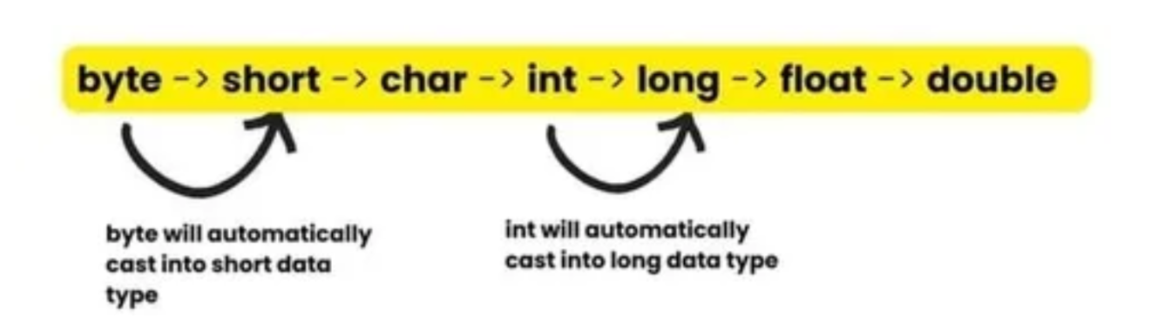
For example, if you assign an integer value to a variable of type double, Java will automatically convert the integer to a double. This is because the range of values that can be stored in a double is larger than the range of values that can be stored in an integer.

Slide 16
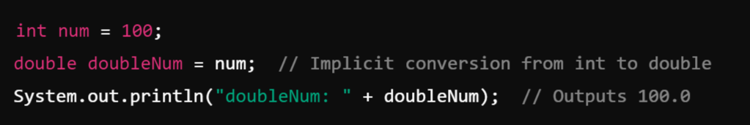
Example:

Slide 17
b. Explicit Type Conversion (Casting):
Definition: When you need to convert a larger data type into a smaller data type, or when you need to explicitly convert between types, you must perform explicit casting. This is also called narrowing conversion.
In this process there is high chance that we will lose our data.
Converting a higher data type into a lower one is called narrowing type casting. It is also known as explicit casting or casting down. It is done manually by the programmer. If we do not perform casting, then the compiler reports a compile-time error.
This type of casting happens when
Both data types must be compatible with each other.
The target type must be smaller than the source type.

Slide 18

For example, if you assign a double value to a variable of type int, you will need to manually convert the double to an int using an explicit cast. This is because the range of values that can be stored in an int is smaller than the range of values that can be stored in a double.
To perform an explicit type cast in Java, you place the desired data type in parentheses before the variable that you want to cast.

Slide 19
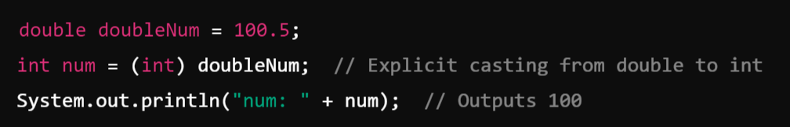
For example:
Note:
It is important to note that explicit type casting can result in data loss if the value being cast is too large to be stored in the new data type. In such cases, the value will be truncated to fit into the new data type, which may result in unexpected behavior.

Slide 20
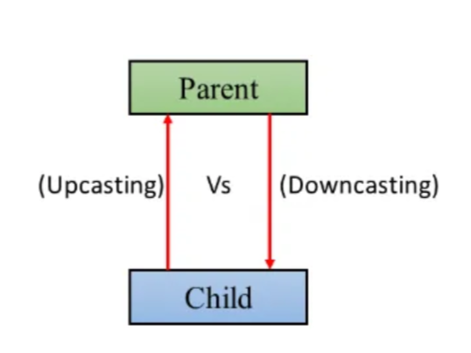
2. Class Type Casting: (Casting between Objects):
Upcasting Vs Downcasting in Java

Slide 21
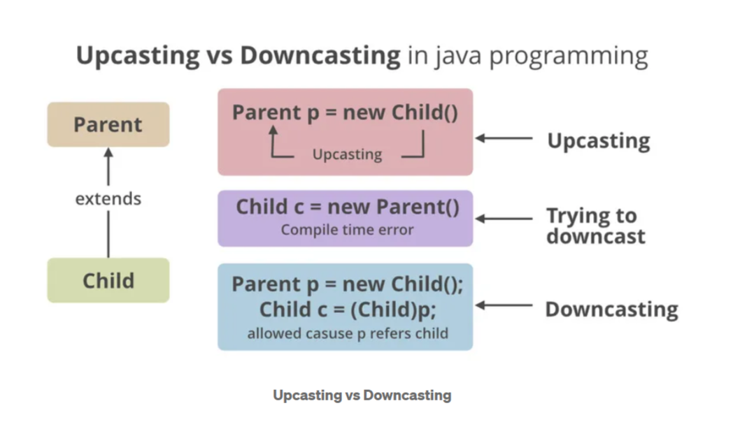

Slide 22
a. Upcasting in Java
Upcasting is the process of converting an object of a subclass to an object of its superclass. This is generally done implicitly by the compiler and is often used to store objects of different subclasses in a collection or array of the superclass type.
For example, if you have a collection of animals, which includes dogs, cats, and birds, you can store all these objects in an ArrayList of the Animal class, which is the superclass of the Dog, Cat, and Bird classes.

Slide 23
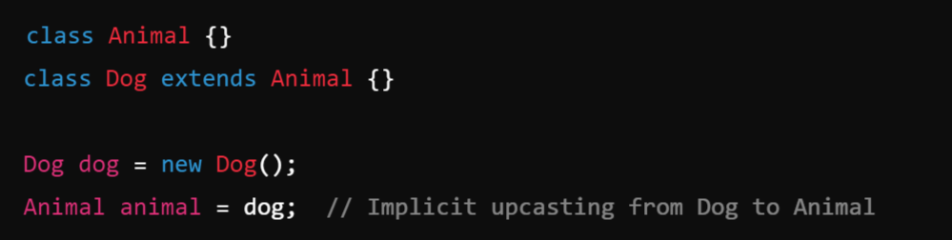
Example:

Slide 24
b. Downcasting in Java
Downcasting is the process of converting an object of a superclass to an object of its subclass. This is an explicit operation that must be performed using the cast operator and can be risky because it may result in a ClassCastException if the object is not actually an instance of the subclass. Downcasting is often used to access methods and properties that are specific to a subclass after an object has been upcasted to its superclass.
For example, if you have an ArrayList of animals and you know that some of the objects in the list are actually dogs, you can downcast those objects to Dog objects in order to call methods that are specific to the Dog class.

Slide 25
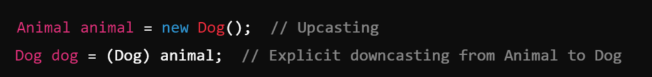
Example:

Slide 26
Garbage Collection:
In Java is an automatic memory management process that helps reclaim memory occupied by objects that are no longer in use, thus preventing memory leaks and optimizing the application’s performance.

Slide 27
Module-2:
MULTIPLE INHERITANCE

Slide 28
Inheritance:
Inheritance is a fundamental concept in object-oriented programming (OOP) that allows a new class (known as a subclass or child class) to inherit properties and behaviors (fields and methods) from an existing class (known as a superclass or parent class). This promotes code reusability and establishes a natural hierarchical relationship between classes.
Key Points:
Super Class (Parent Class):
The class from which properties and methods are inherited.
Example: Animal might be a superclass.
Sub Class (Child Class):
The class that inherits from another class. It can add its own properties and methods, or override the inherited ones.
Example: Dog might be a subclass of Animal.

Slide 29
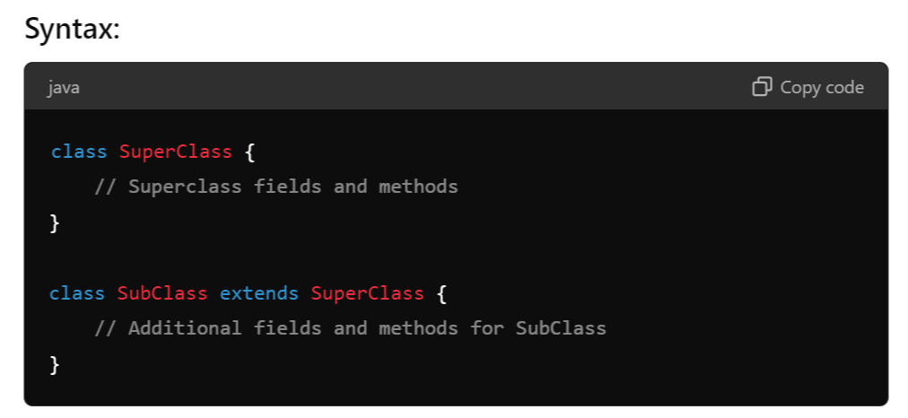

Slide 30
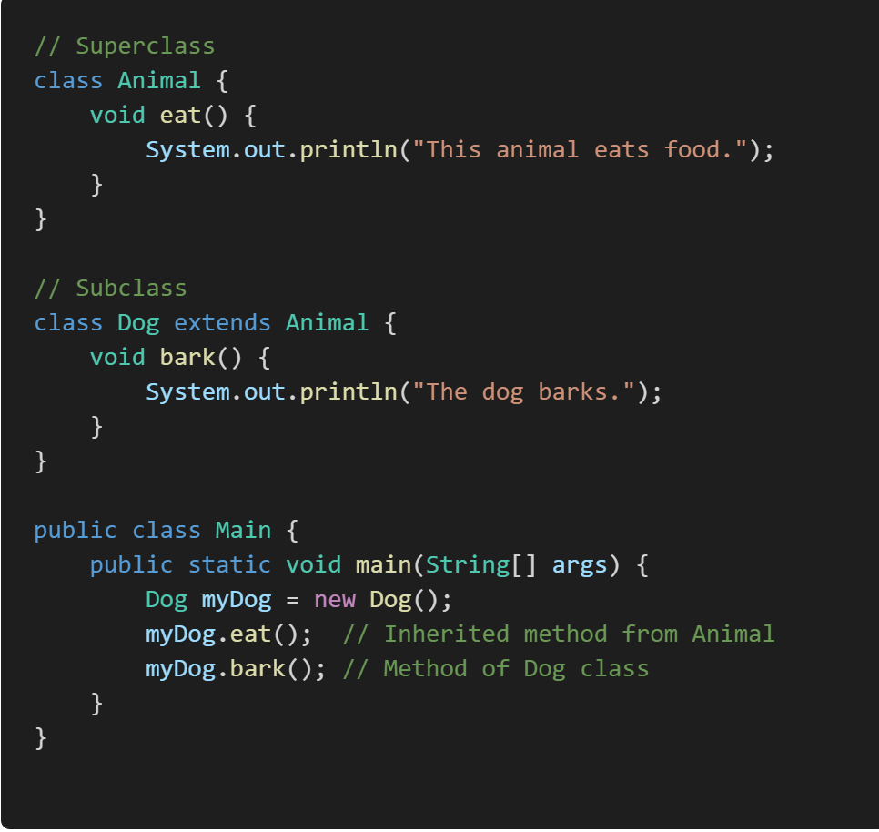
Example:

Slide 31
Inheritance Hierarchies:
An inheritance hierarchy represents the relationships among classes in a multi-level manner, where classes are derived from other classes in a chain.
Single Inheritance: A subclass inherits from only one superclass.
Multi-Level Inheritance: A chain of inheritance where a class is derived from another derived class.
Multiple Inheritance: A class derived from more than one Super class.
Hierarchical Inheritance: Multiple subclasses inherit from a single superclass.
Hybrid Inheritance: A combination of more than one type of inheritance.
Note:
Java doesn't directly support multiple inheritance due to the Diamond Problem, but it can be achieved through interfaces.

Slide 32
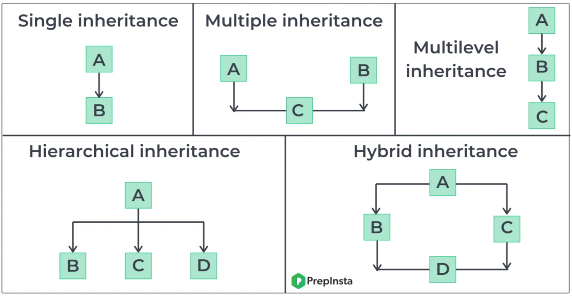

Slide 33
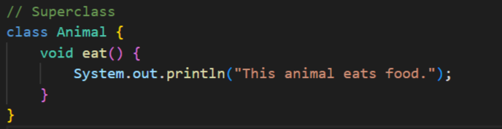
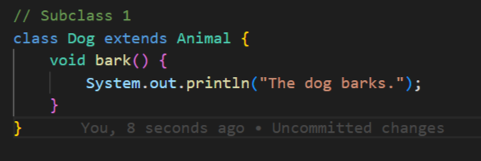
Example:

Slide 34
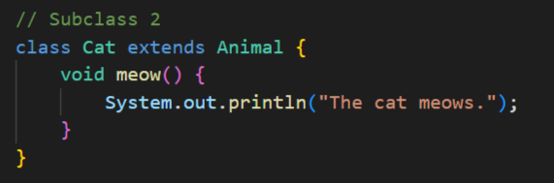
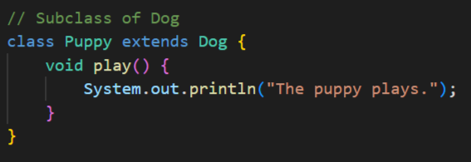

Slide 35
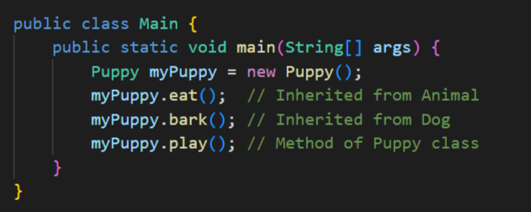

Slide 36
super Keyword:
The super keyword in Java is used in three main contexts:
Accessing the Parent Class Constructor
Accessing Parent Class Methods
Accessing Parent Class Fields
Overall, super is mainly used to differentiate between members of a parent class and the current class, ensuring the correct fields, methods, or constructors are accessed.
Note:
super: The super keyword is used to refer to the immediate parent class. However, super can only be used within a method or a constructor. You cannot use super directly in the class body

Slide 37
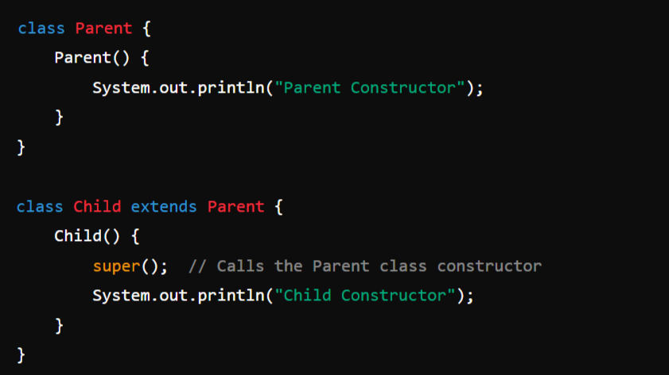
1. Accessing the Parent Class Constructor:
It is used to call a constructor of the parent class from a subclass. This is typically done to initialize the parent class's fields when an instance of the subclass is created.
Example:

Slide 38
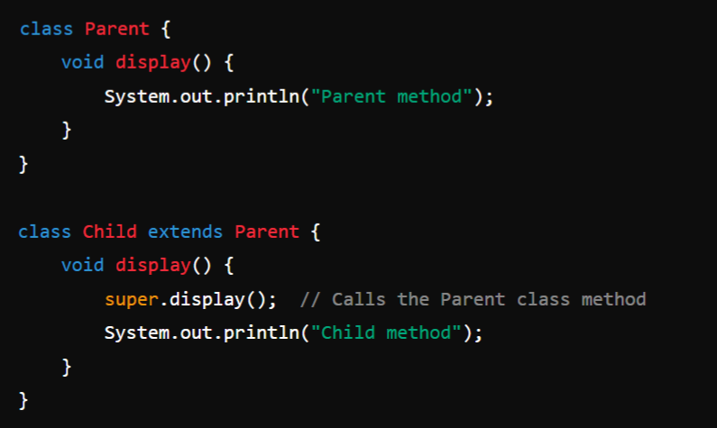
2. Accessing Parent Class Methods:
super can be used to call a method from the parent class that has been overridden in the child class.
Example:

Slide 39
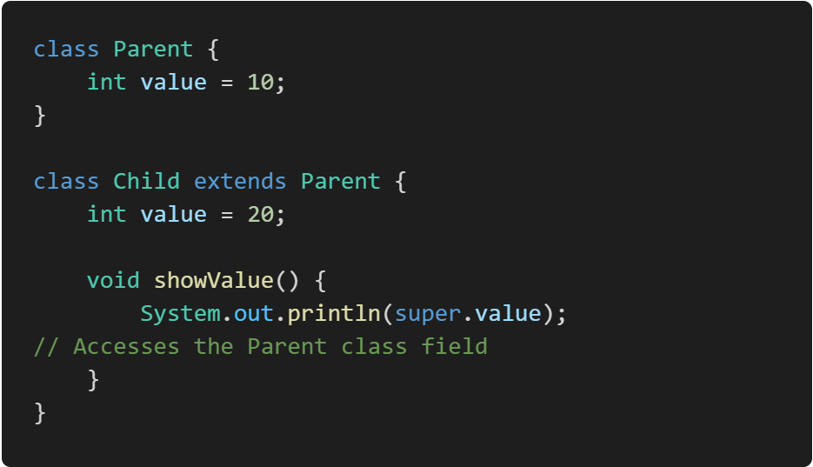
3. Accessing Parent Class Fields:
If a field in a subclass hides a field in its superclass, super can be used to refer to the superclass's field.
Example:

Slide 40
Preventing inheritance:
final Keyword:
In Java, the final keyword can be applied to classes and methods to restrict their usage or modification.

Slide 41
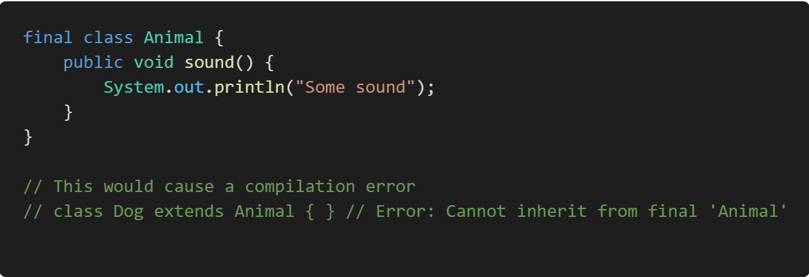
final Classes:
A final class is a class that cannot be subclassed or extended. This is useful when you want to prevent other classes from inheriting your class, ensuring that its implementation remains unchanged.
Example:

Slide 42
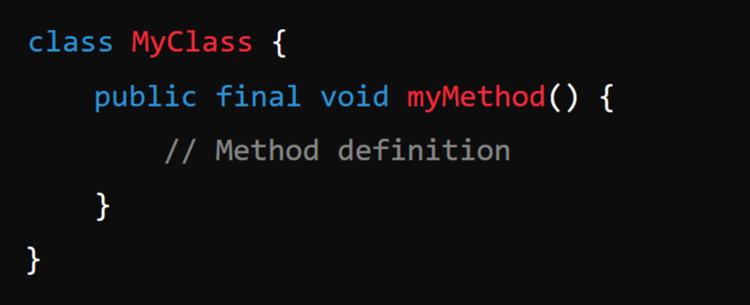
final Methods:
A final method is a method that cannot be overridden by subclasses. This is useful when you want to ensure that a method's implementation remains unchanged in any subclass.
Syntax:

Slide 43
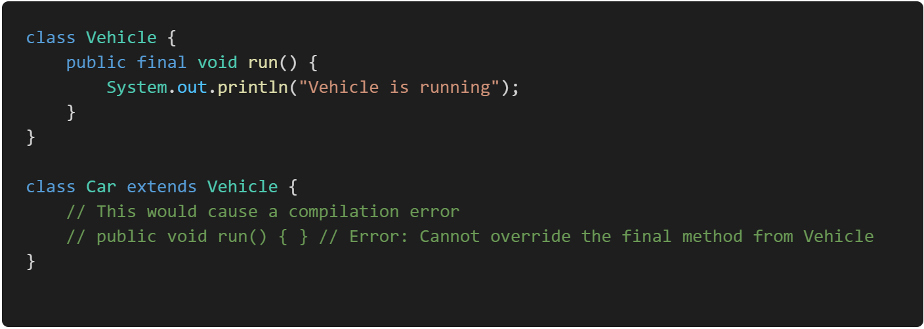
Example:

Slide 44
Module-2: MULTIPLE INHERITANCE
Inheritance: Inheritance hierarchies, super and subclasses, member access rules, super keyword,
Preventing inheritance: final classes and methods, the object class and its methods.
Polymorphism: dynamic binding, method overriding abstract classes and methods.
Module-3: INTERFACES AND PACKAGES
Interface: Interfaces VS Abstract classes, defining an interface, implement interfaces accessing implementations through interface references, extending interface.
Packages: Defining creating and accessing a package, understanding CLASSPATH, importing packages

